Slide 1
Cyber Crimes, Forensics and Incident Handling
Amit Dua

Slide 2
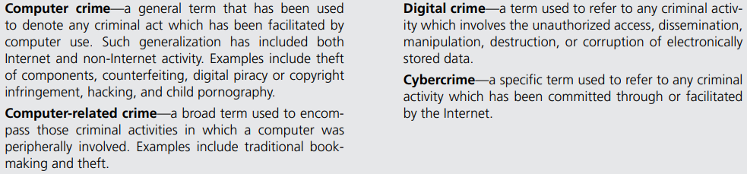
Definitions

Slide 4
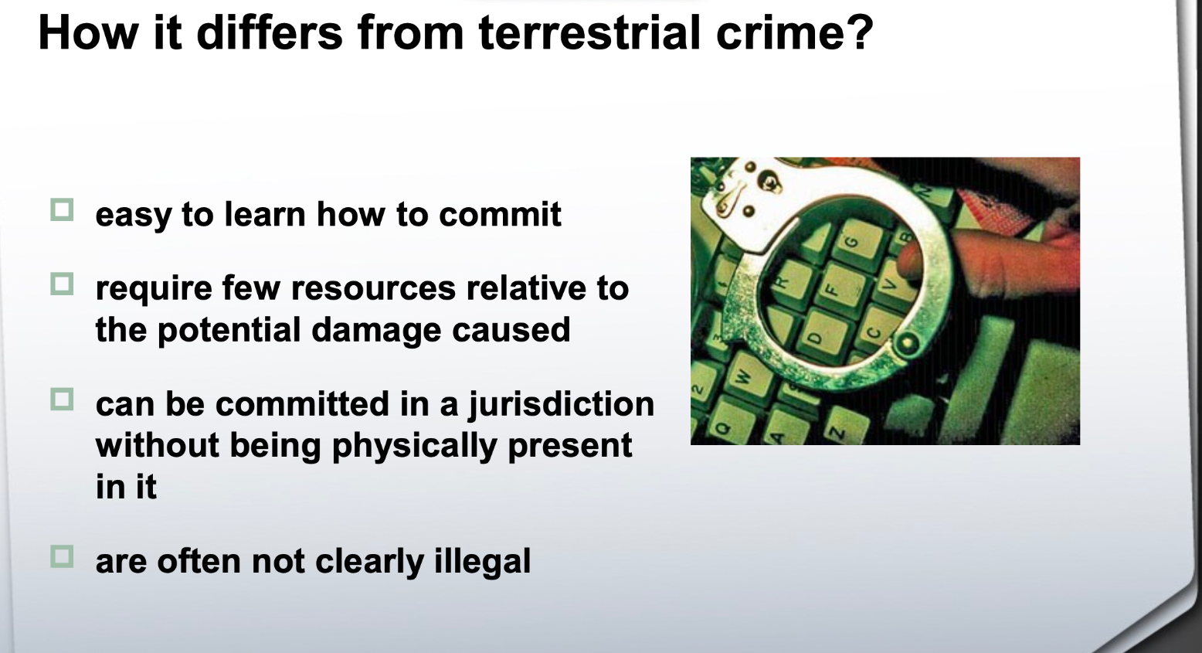

Slide 5
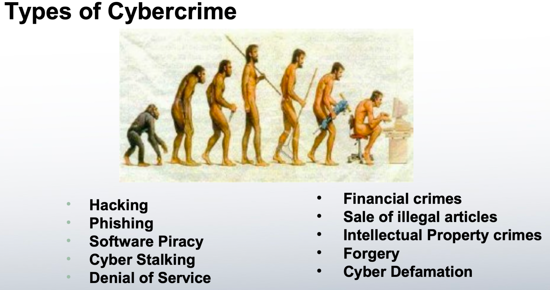

Slide 6
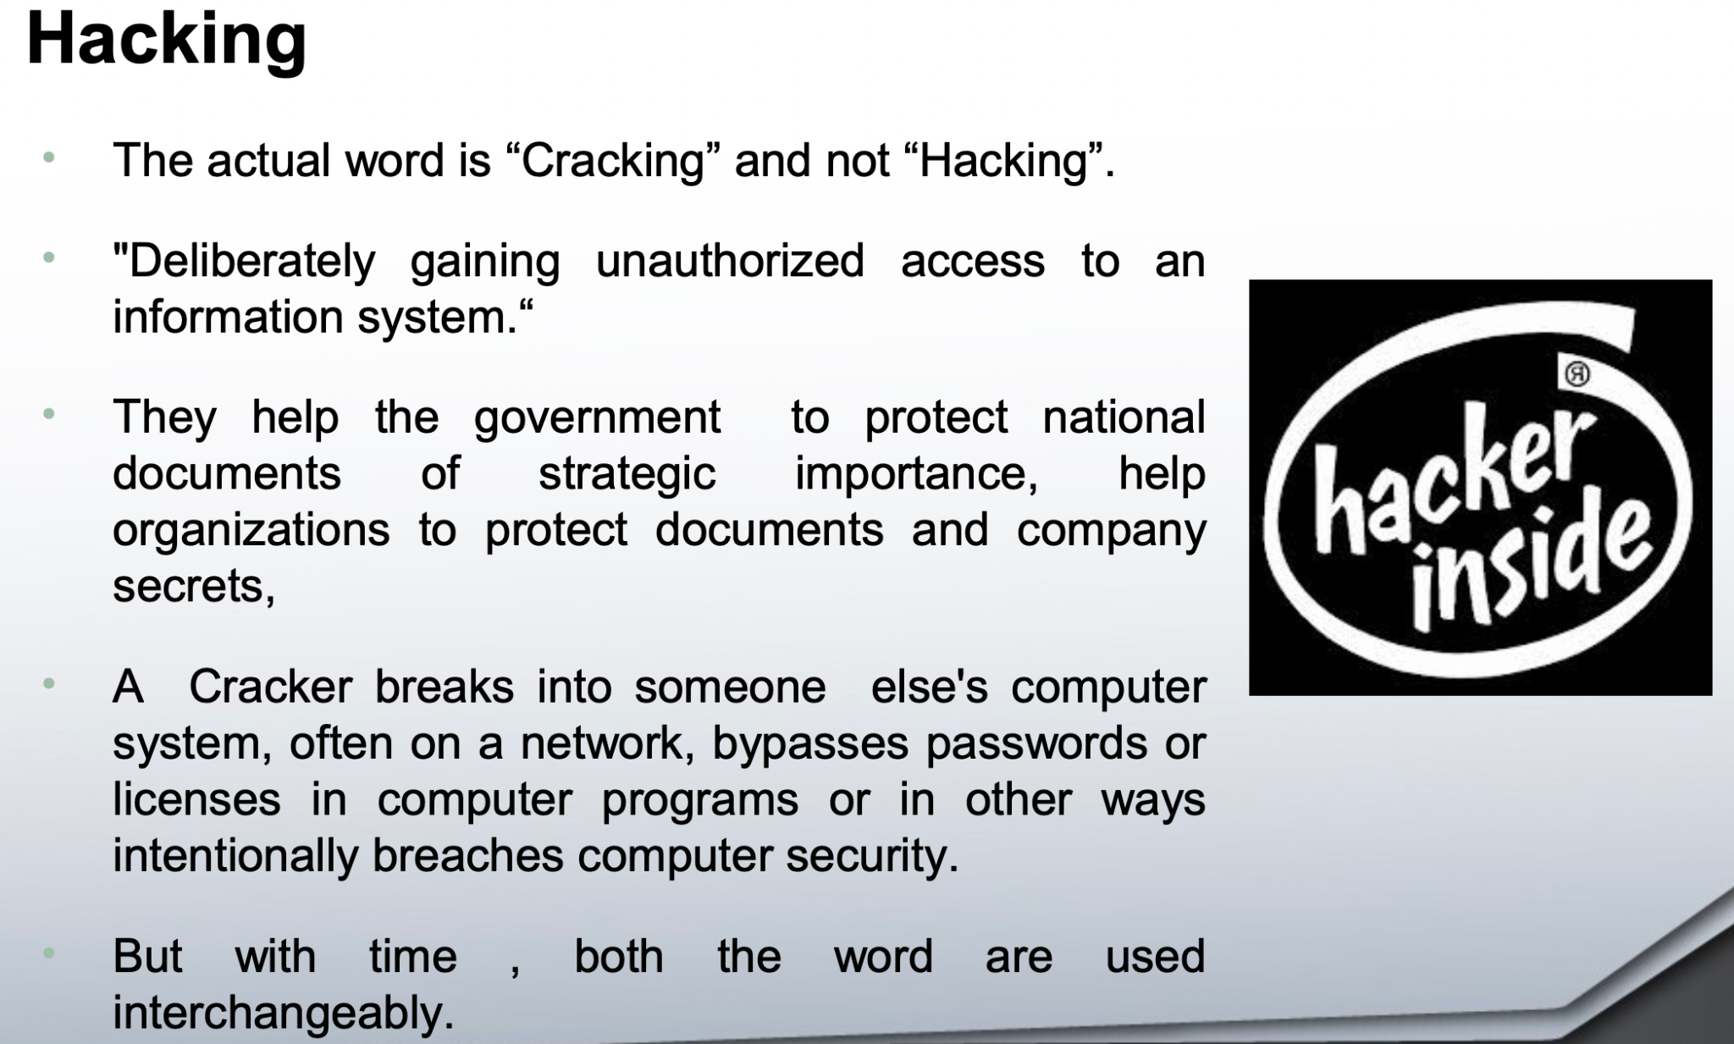

Slide 7
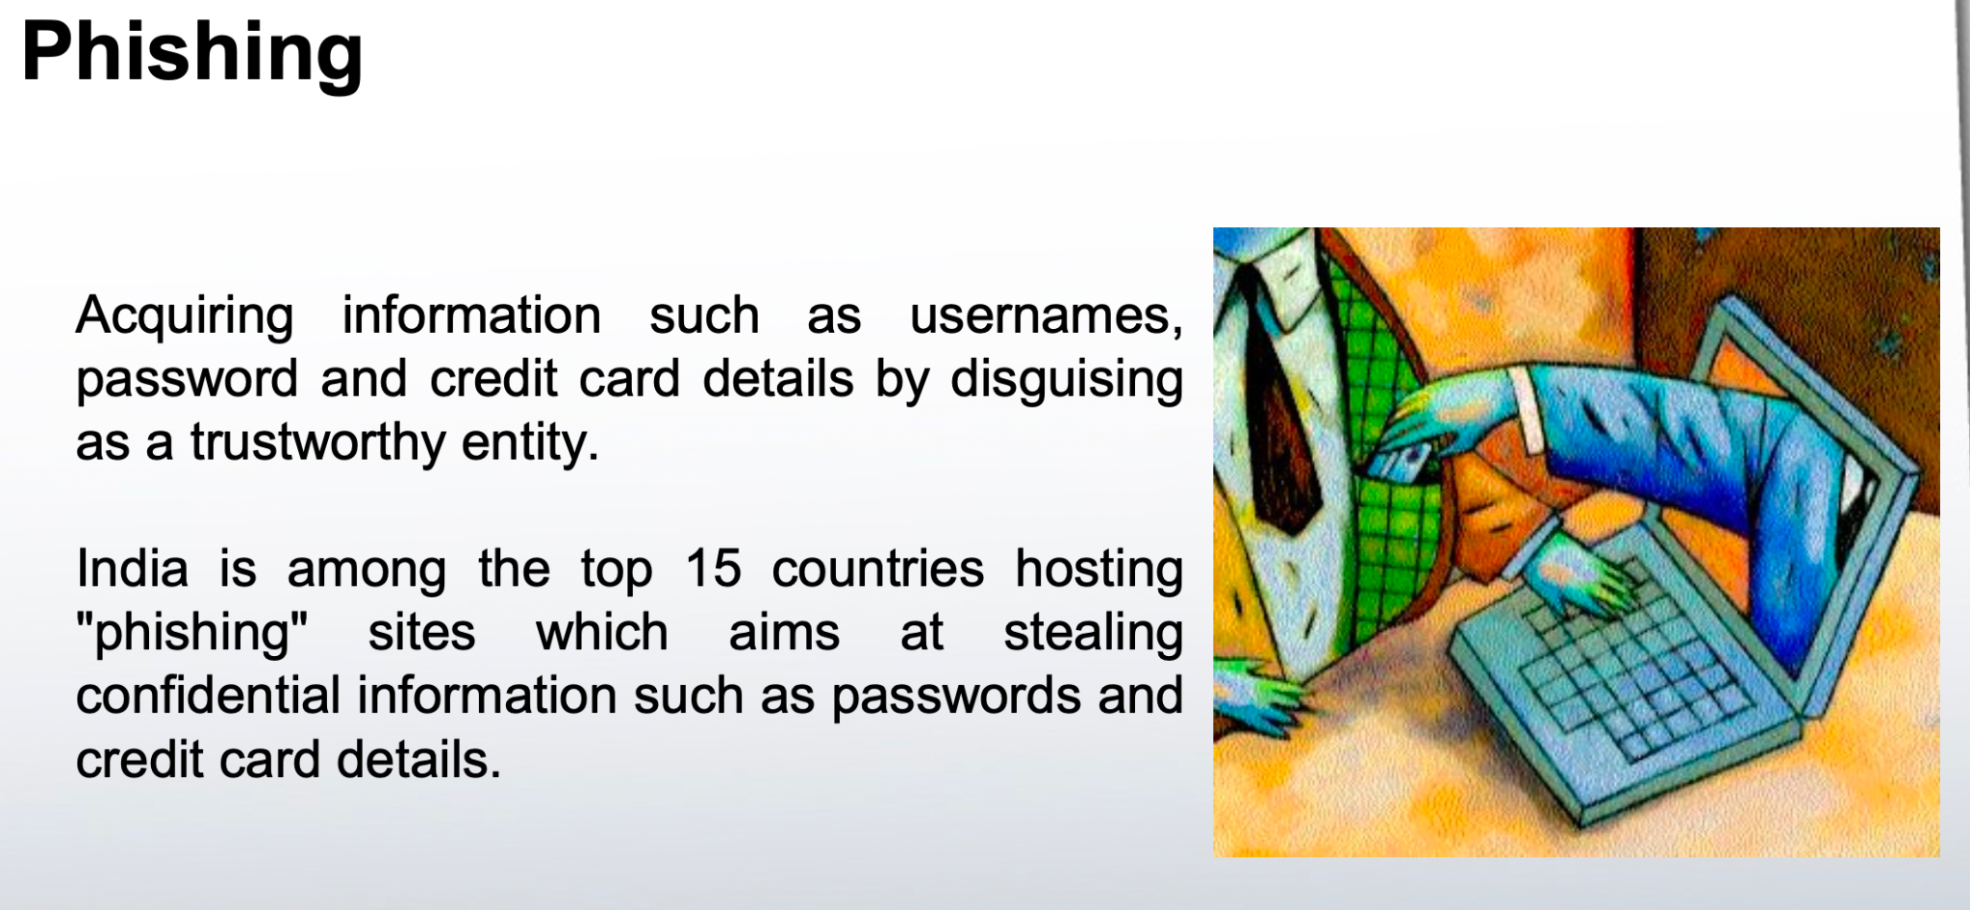

Slide 8
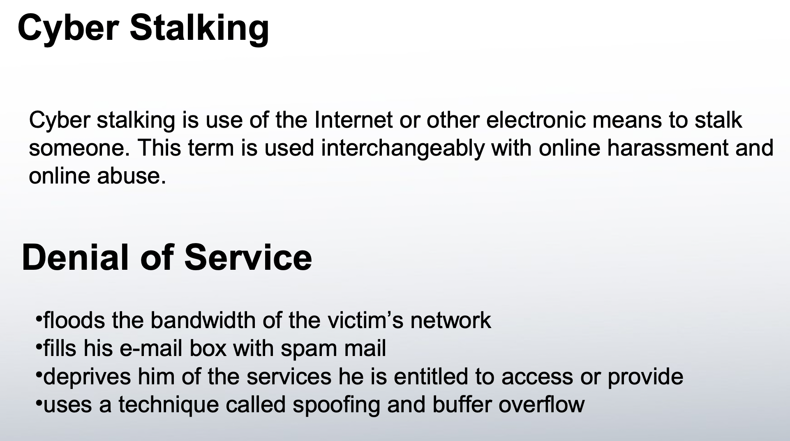

Slide 9
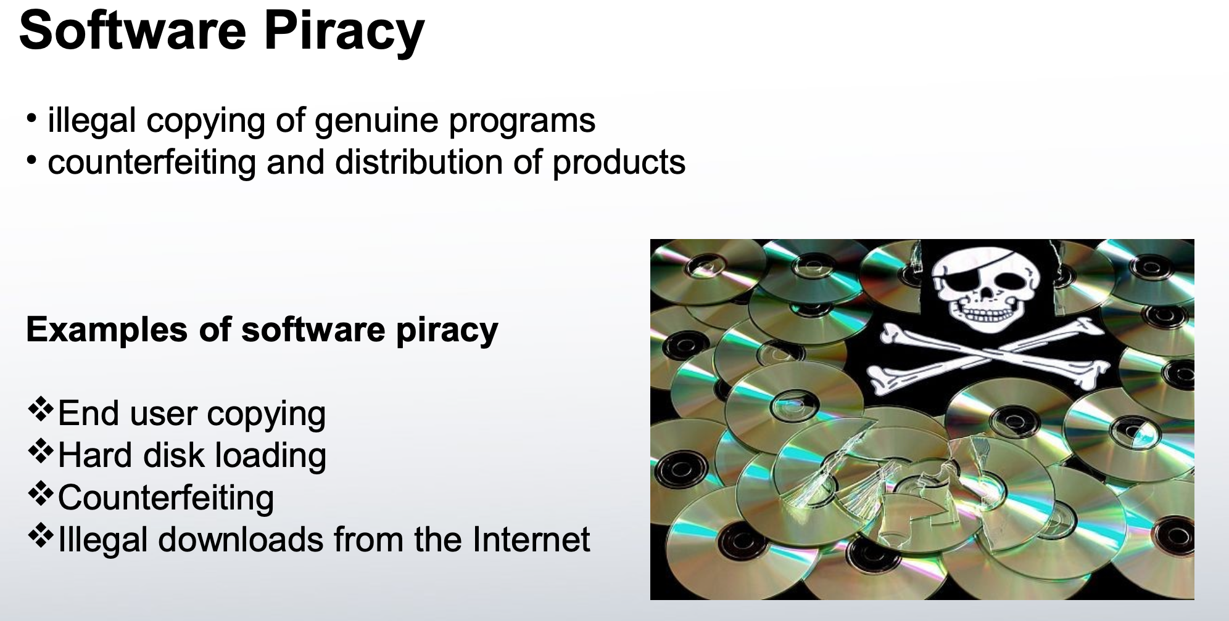

Slide 10
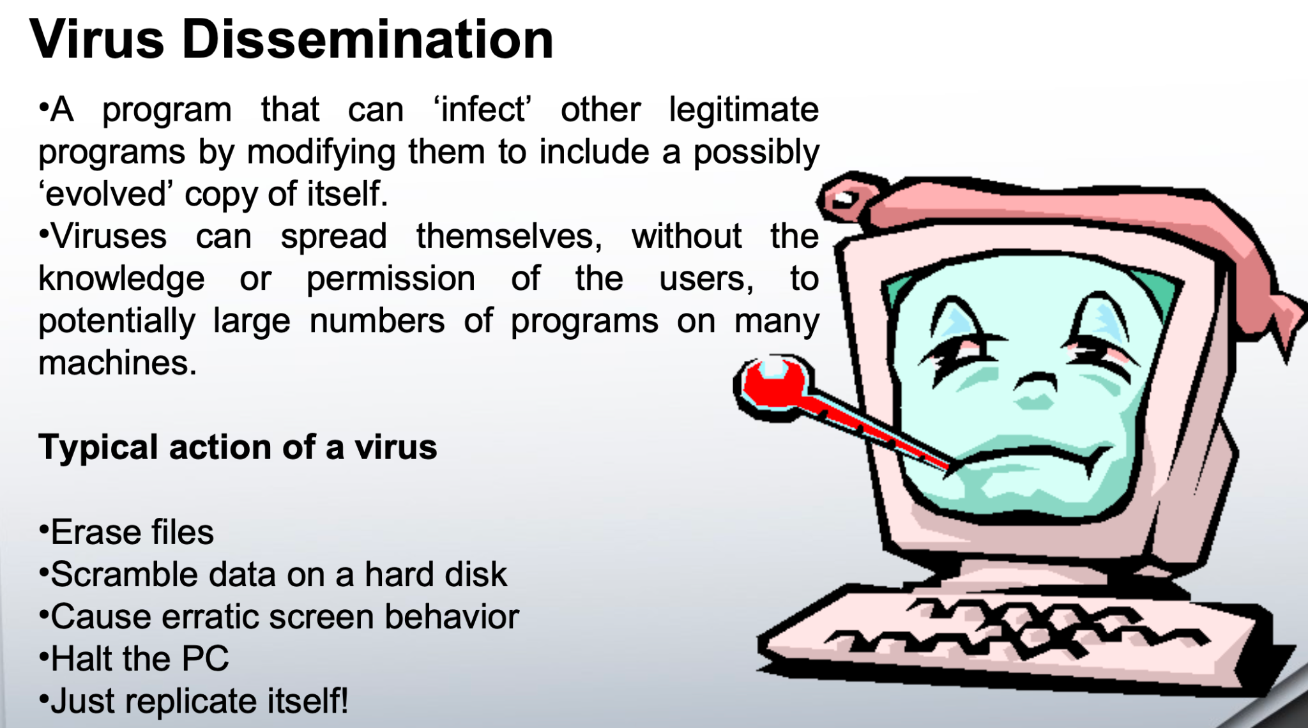

Slide 11
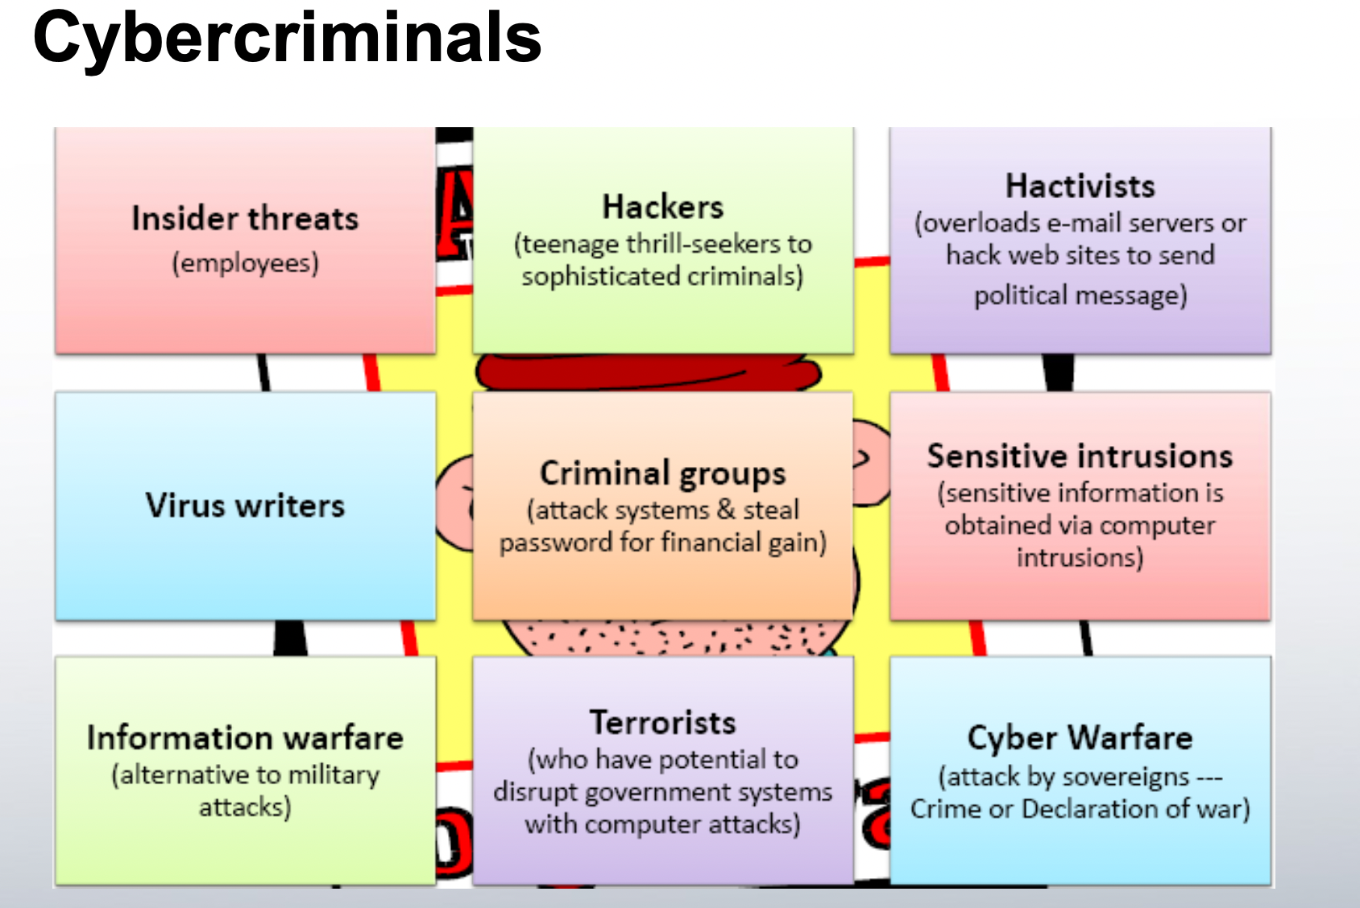

Slide 12
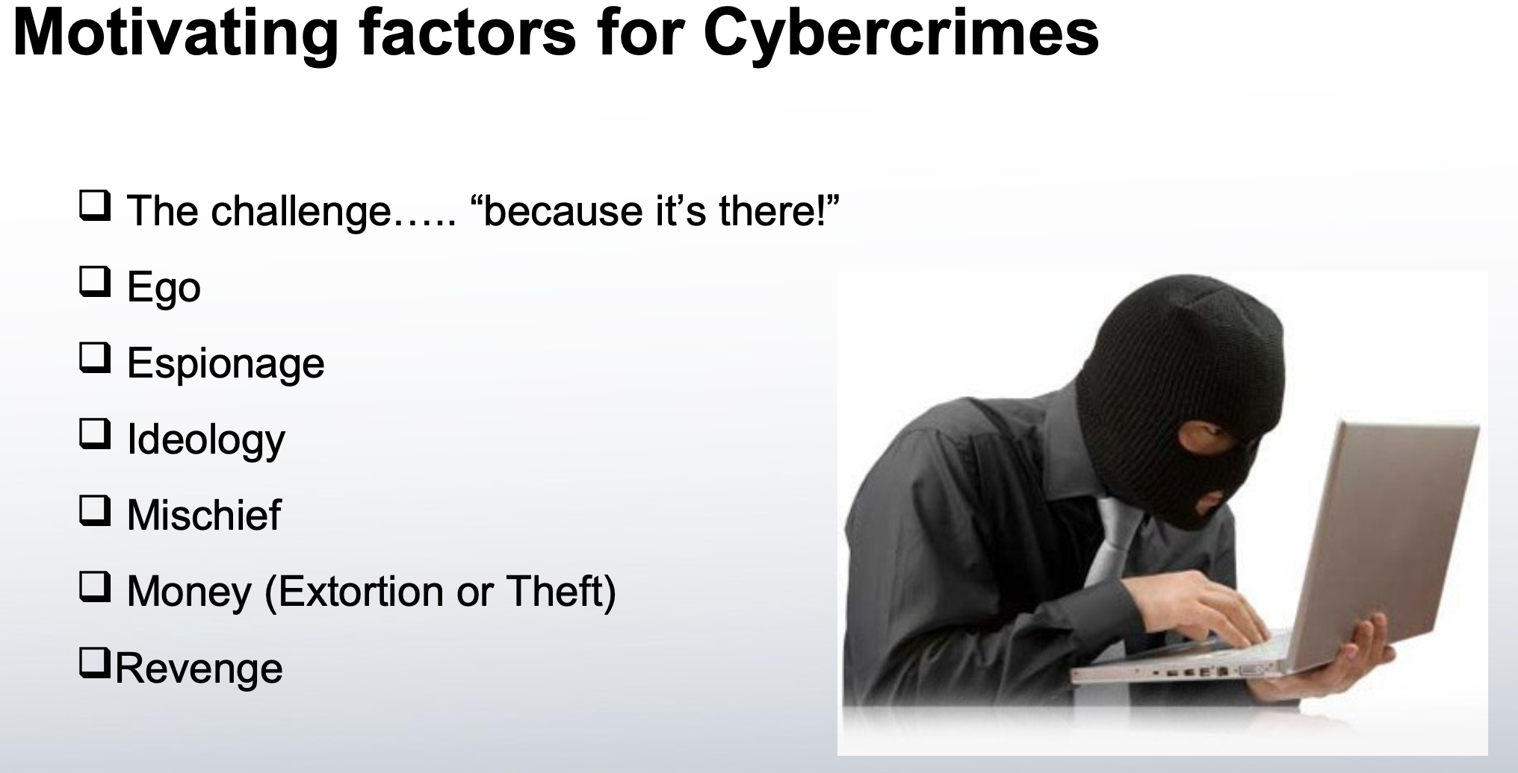

Slide 13
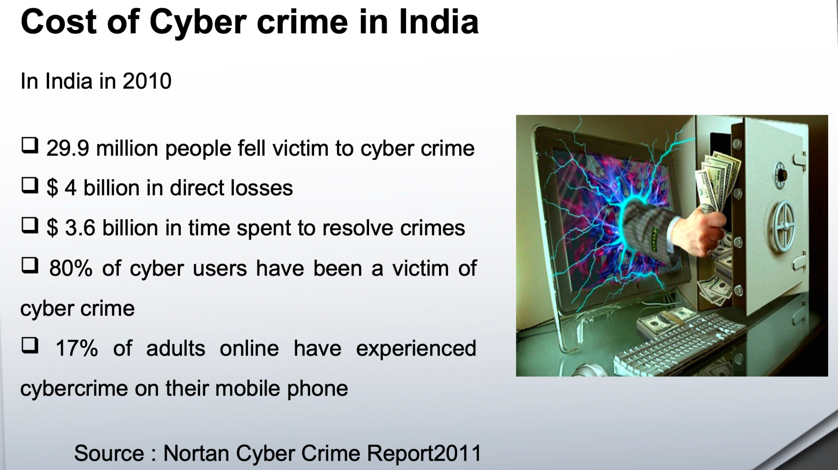

Slide 14
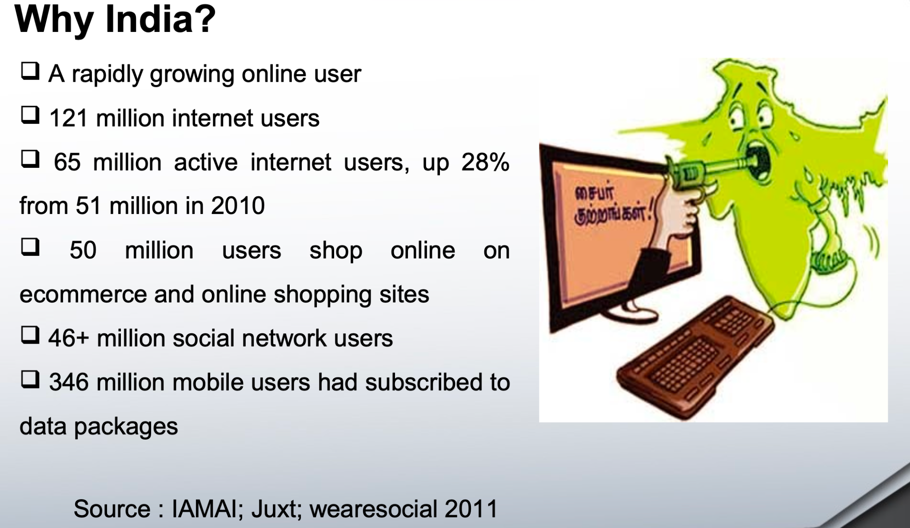

Slide 15
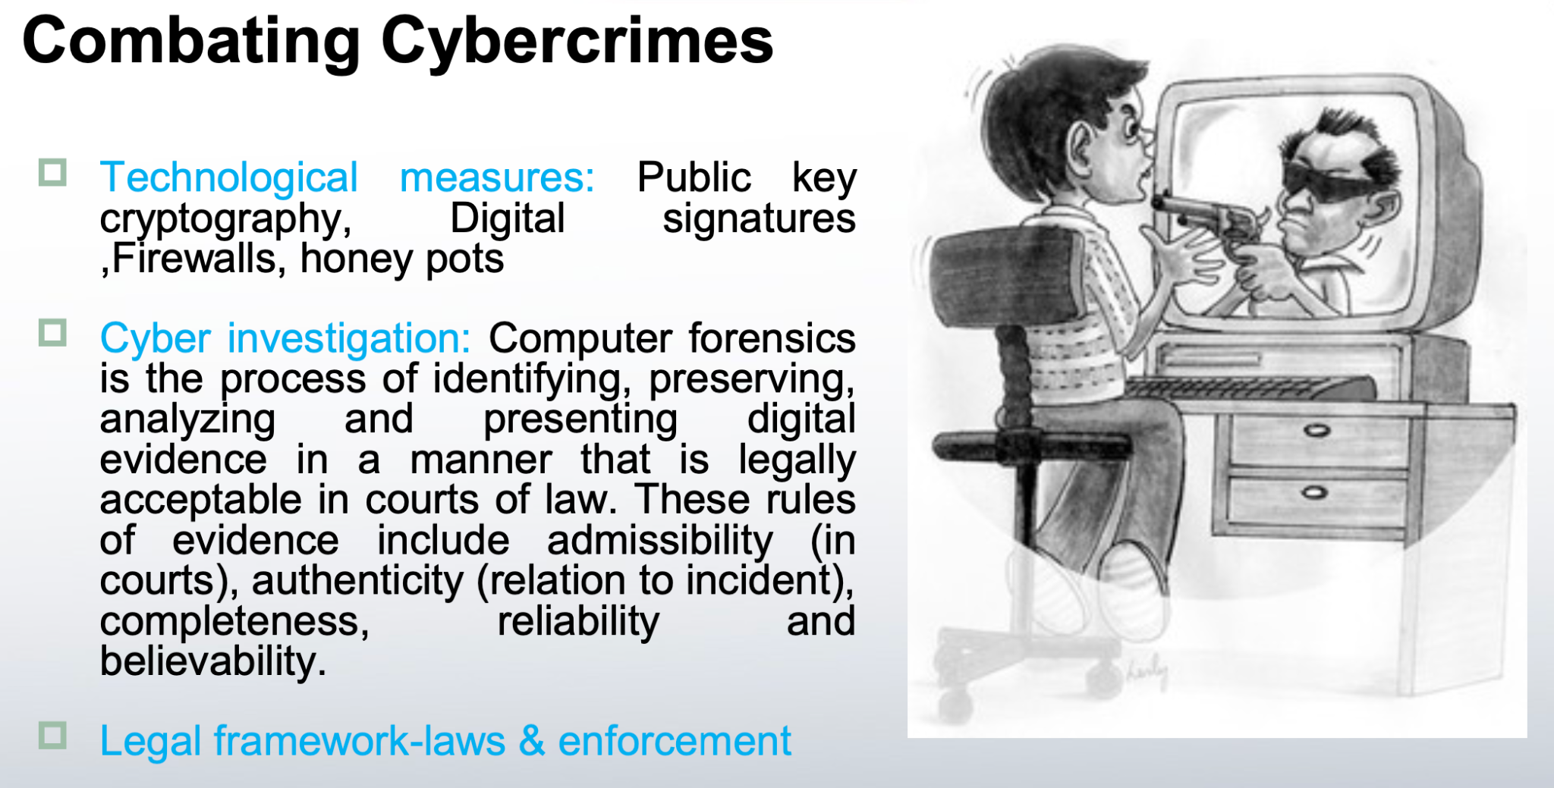

Slide 16
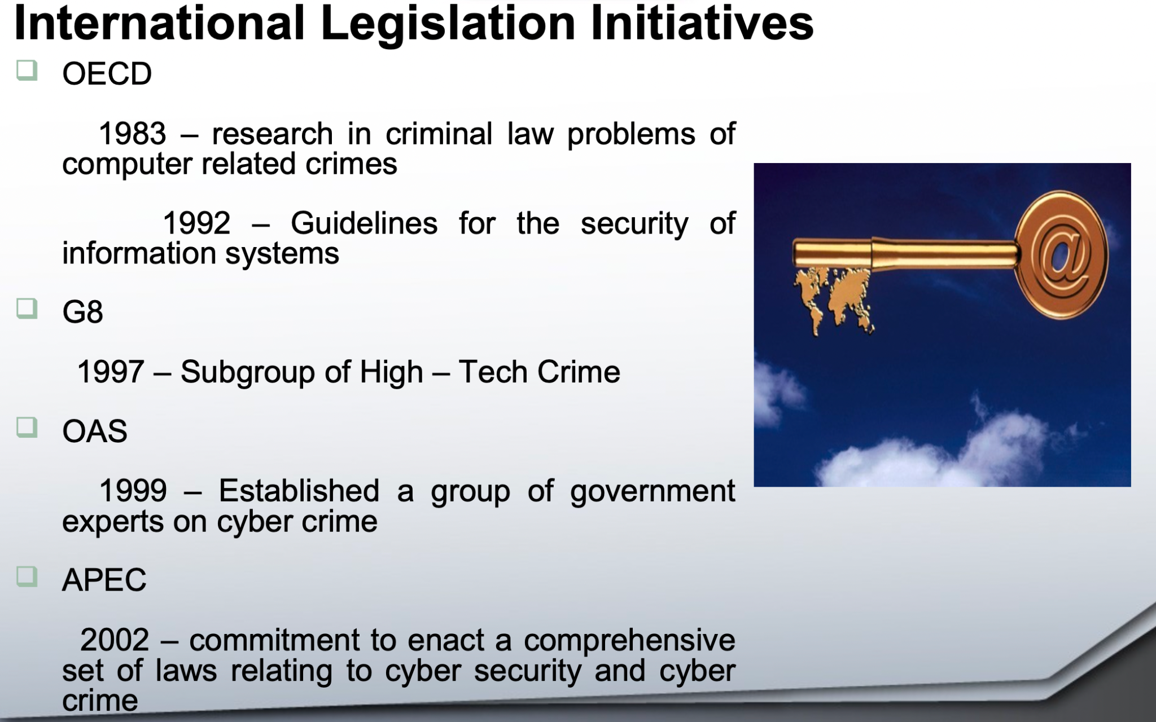

Slide 17
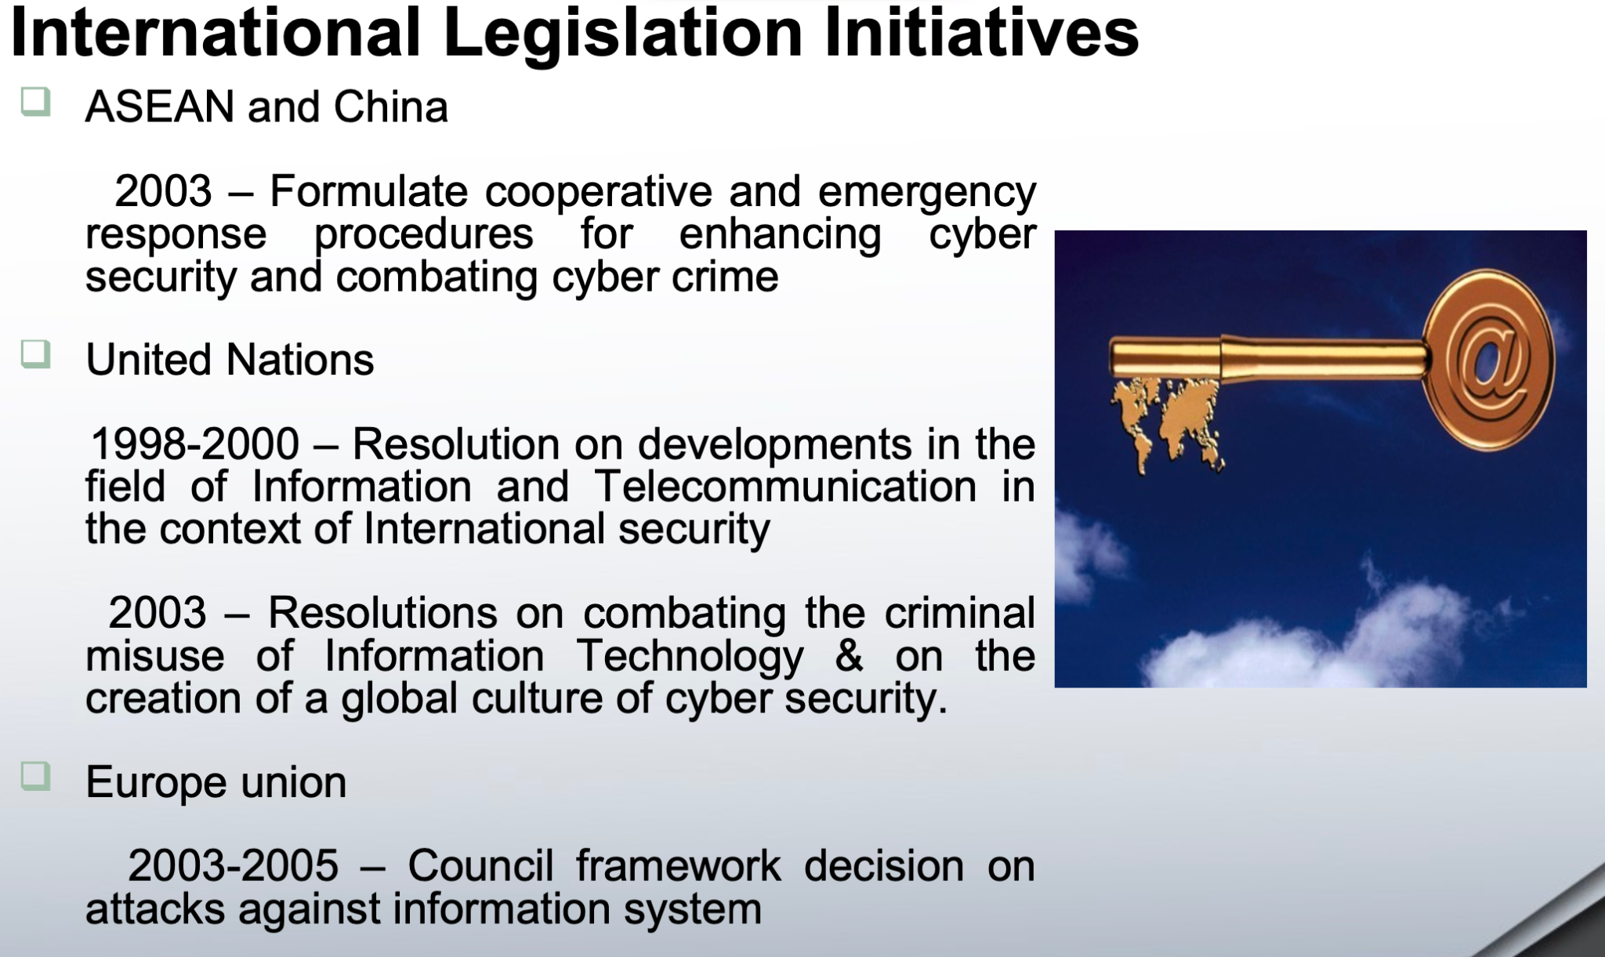

Slide 18
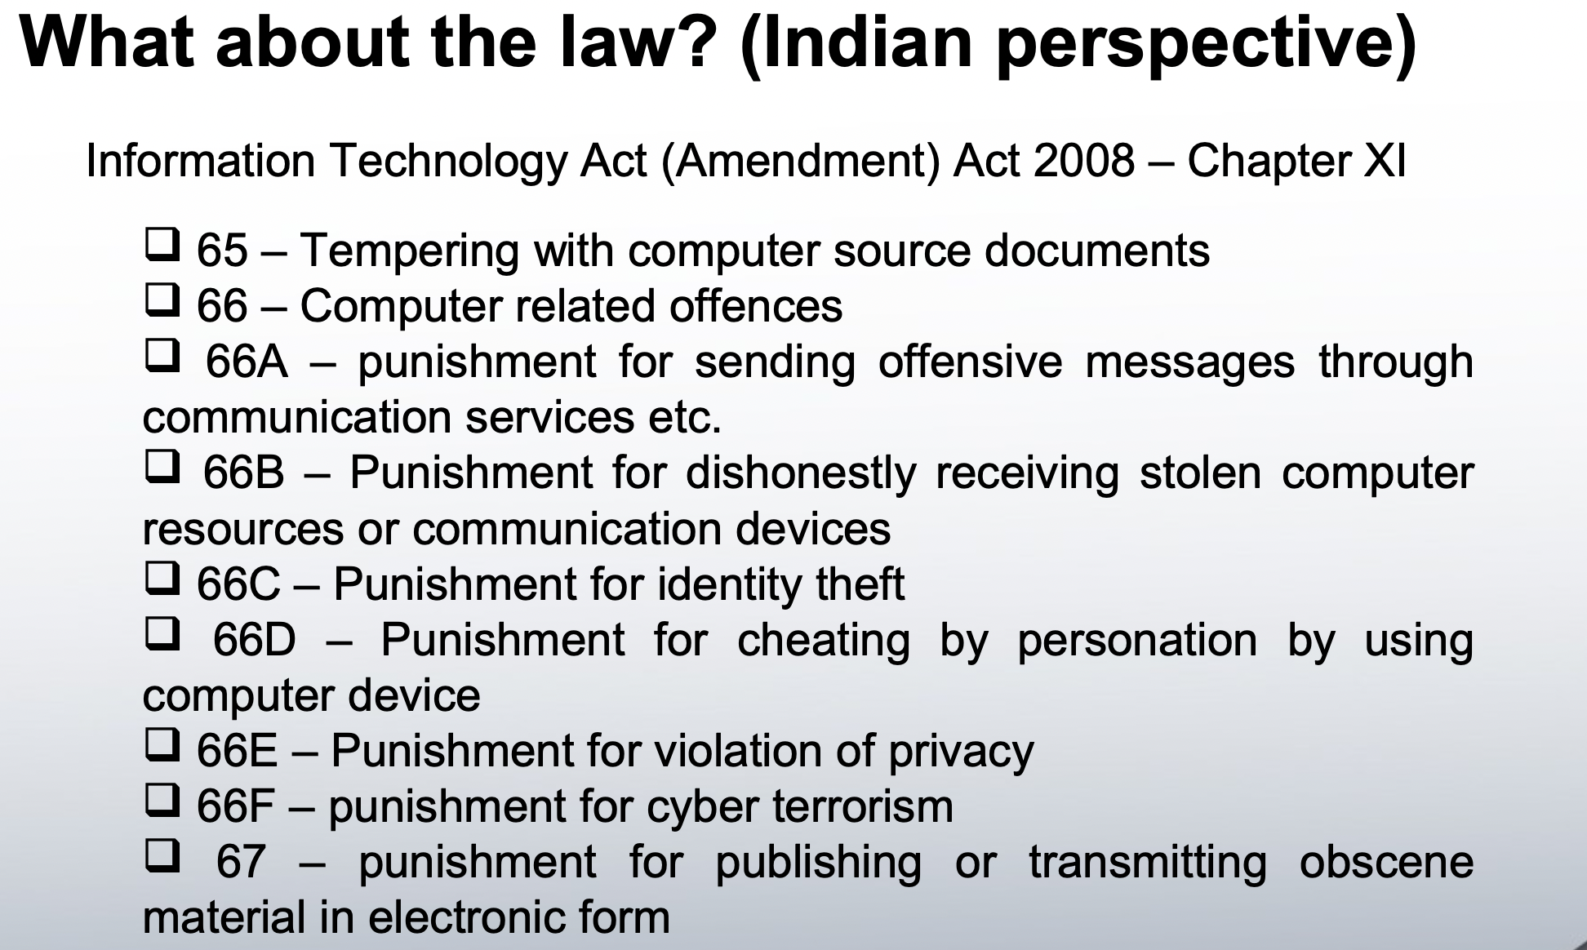

Slide 19
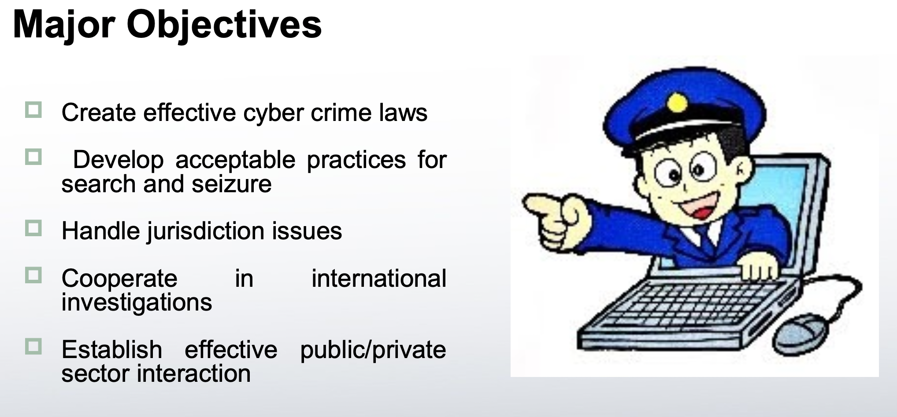

Slide 20
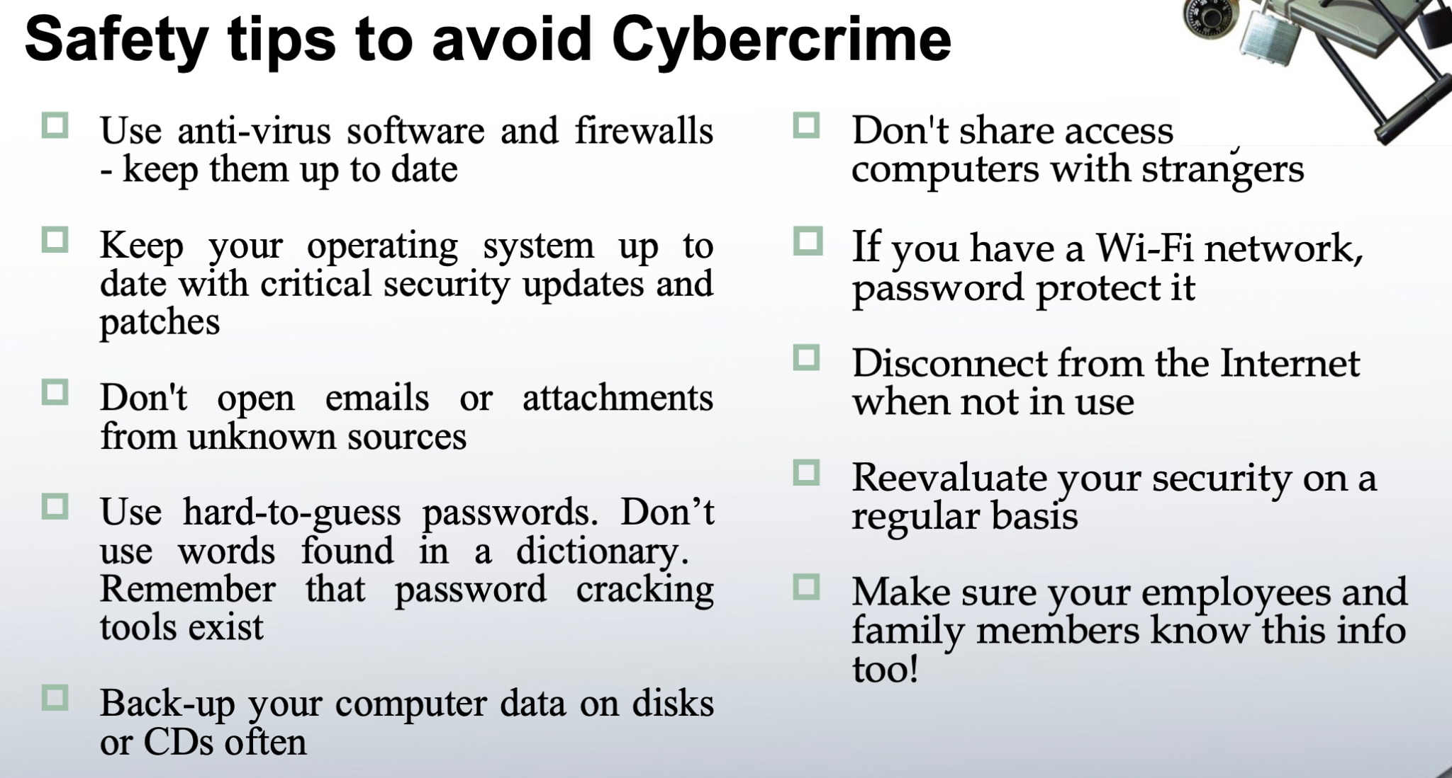

Slide 21
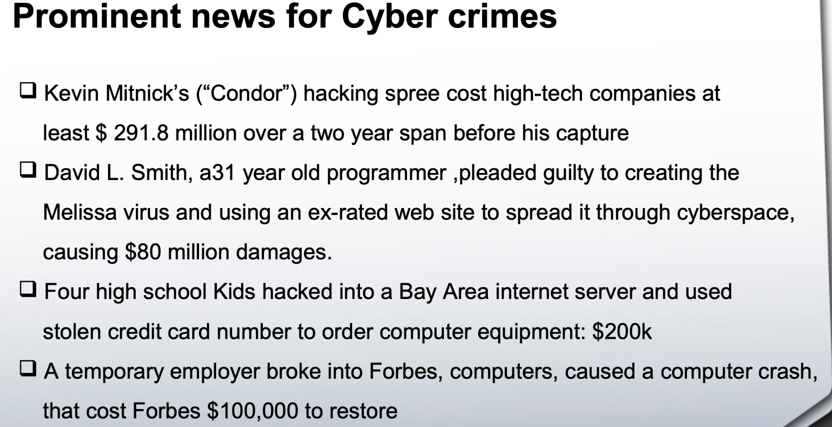

Slide 22
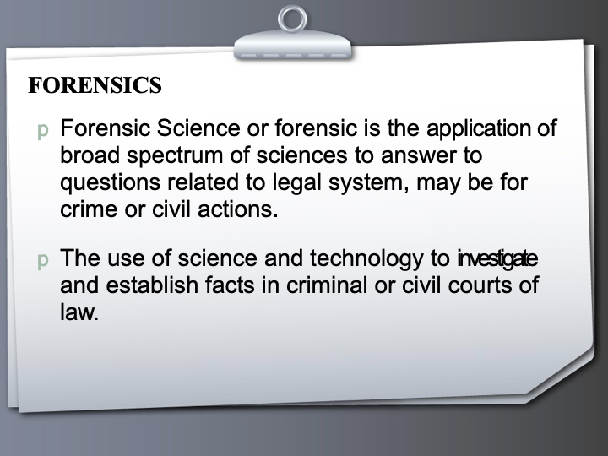

Slide 23
FORENSICS
Forensic Science or forensic is the application of broad spectrum of sciences to answer to questions related to legal system, may be for crime or civil actions.
The use of science and technology to investigate and establish facts in criminal or civil courts of law.

Slide 24
COMPUTER FORENSICS
Goal of computer forensics is to examine digital media in a forensically sound manner with the aim of identifying, preserving, recovering, analyzing and presenting facts and opinions about the information.

Slide 25
HISTORY
Michael Anderson
⇨“Father of computer forensics”
⇨special agent with IRS
Meeting in 1988 (Portland, Oregon)
⇨creation of IACIS, the International Association of Computer Investigative Specialists
⇨the first Seized Computer Evidence Recovery Specialists (SCERS) classes held

Slide 26
WHY?
The main task or the advantage from the computer forensic is to catch the culprit or the criminal who is involved in the crime related to the computers.
Computer forensics has emerged as important part inthe
disaster recovery management
Ability to search through a massive amount of data- Quickly, Thoroughly and In any language
The importance lies mainly in handling criminal actions such as fraud, phishing, identity theft or many other criminal activities

Slide 27
WHO USES FORENSICS
Criminal Prosecutors
Civil litigators
Insurance Companies
Corporations
Law Enforcement Officials
Individuals

Slide 28
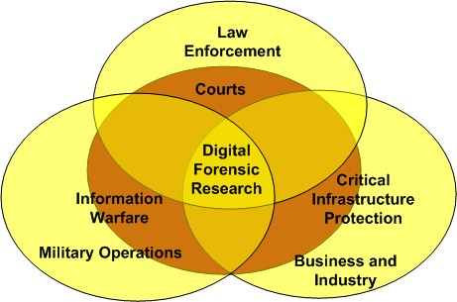

Slide 29
What cyber forensics aims at?
❐
Identify root cause of an event to ensure it won’t happen again
– Must understand the problem before you can be sure it won’t be exploited again.
Who was responsible for the event?
Most computer crime cases are not prosecuted
– Consider acceptability in court of law as our standard for investigative practice.
❐
❐
Ultimate goal is to conduct investigation in a manner that will stand up to legal scrutiny.
Treat every case like a court case!

Slide 30
STEPS FOR COMPUTER FORENSICS:
Acquisition
Identification
Evaluation
Presentation

Slide 31
Shut Down the Computer
Document the Hardware Configuration of The System
Transport the Computer System to A Secure Location
Make Bit Stream Backups of Hard Disks and Floppy Disks
Mathematically Verify Data on All Storage Devices
Document the System Date and Time
Make a List of Key Search Words
Evaluate the Windows Swap File
Evaluate File Slack
Evaluate Unallocated Space (Erased Files)
Search Files, File Slack and Unallocated Space for Key Words
Document File Names, Dates and Times
Identify File, Program and Storage Anomalies
Evaluate Program Functionality
Document Your Findings
METHEDOLOGY:

Slide 32
EVIDENCES:
Forensics involves collection of evidences as an important part for investigation. 5 rules of evidences:
1) Admissible
Must be able to be used in court or elsewhere.
1) Authentic
Evidence relates to incident in relevant way.
1) Complete
Exculpatory evidence for alternative suspects.
1) Reliable
No question about authenticity & veracity.
1) Believable
Clear, easy to understand, and believable by a jury.

Slide 33
TOP 10 LOCATION FOR EVIDENCE
Internet History Files
Temporary Internet Files
Slack/Unallocated Space
Buddy lists, personal chat room records, P2P, others saved areas
News groups/club lists/posting
Settings, folder structure, file names
File Storage Dates
Software/Hardware added
File Sharing ability
E-mails

Slide 34
TOOLS AND TECHNIQUES
❐ There are two types of computer data
Persistent data
Volatile data
There are different tools used to collect data
An essential toolkit should contain-backup, authentication, decryption, disk editing, log file auditing, IP tracking, data recovery, and file examination.
Tools used depend on what data has to be analyzed

Slide 35
Some common tools:
Drivespy
Encase
Forensic tool kit
I Look
Norton utilies
Xways

Slide 36
TECHNIQUES:
Cross Drive Analysis
Deleted files analysis
Live analysis

Slide 37
DISADVANTAGES
It may happen in some cases that the privacy of the client is compromised.
There are also the chances of introduction of some malicious programs in the computer system that may corrupt the data at a later stage of time.
❐
It is also possible that the data is in dispute and neither of the disputing parties can use the data. Due to this reason the business operations may also be affected.
Producing electronic records & preserving them is extremely costly
Legal practitioners must have extensive computer knowledge and vice versa

Slide 43
Forensic science
computer forensic science, computer forensics, and digital forensics may be defined as the methodological, scientific, and legally sound process of examining computer media and networks for the identification, extraction, authentication, examination, interpretation, preservation, and analysis of evidence.

Slide 44
Traditional Problems Associated with Computer Crime
Physicality and Jurisdictional Concerns
Perceived Insignificance, Stereotypes, and Incompetence
Prosecutorial Reluctance
Lack of Reporting
Lack of Resources
Jurisprudential Inconsistency
Extent of the Problem

Slide 45
The Emergence of e-Cash: A New Problem for Law Enforcement
Prepaid Cards
Stored Value Cards
Mobile Payments
Internet Payment Services
Digital Precious Metals

Slide 46
challenges that technologies face in cybersecurity
Supply chain interconnection
Hacking
Phishing
Lack of uniformity in devices used for internet access
Lack of awareness

Slide 47
Case
Rahul received a whatsapp forward with a link to a lucky draw game.
What happened here?
What could he have done here to prevent the crime?

Slide 48
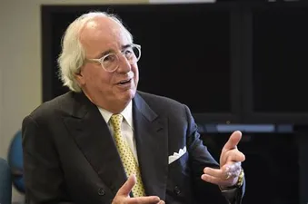
“Every case involving cybercrime that I’ve been involved in, I’ve never found a master criminal sitting somewhere in any country. It always ends up that somebody at the company did something they weren’t supposed to do. They read an email, went to a website they weren’t supposed to.“
- Frank Abagnale

Slide 49
Types of Cybercrime
Phishing:
Hacking:
Smishing:
Vishing:
Identity theft:
Cyber stalking:
Ransomware attacks:
Through malware:
VOIP:

Slide 50
Deepfake:
Web Jacking:
Data diddling:
Denial of services (DoS):
Drive by download attack
Watering hole attack:
Tailgating:
Juice Jacking:
Business Email Communication scams:
Whaling attack:
Using Digital voice assistants:

Slide 51
Different cyber crimes
Debit card cloning

Slide 52
What we should do
Make sure you never give your ATM card and pin number to anyone, no matter how close they are to you. Not even your closest relatives and family members.
Check for extra layering in the area where you insert your card for skimmers.
Also cover the keyboard while entering the pin because there may be suspicious cameras lying around tracking the keys you enter.
Never share your card details, CVV number and OTP number with anyone over call or in person.
If you ever receive an OTP for any transaction which you did not initiate, then you should immediately get your credit card and debit card blocked as it is possible that someone has made an attempt to steal your money.

Slide 53
RBI Guidelines
If a third party was involved and took your money without your knowledge, then the bank is liable to pay you the exact amount that you have lost. If some sort of skimmer device was installed into the ATM because of which your card got cloned without your knowledge, then it is not your liability and the bank has to pay back your amount.

Slide 54
Cont.
2. If you lost your money due to some security flaw of the bank, or if your account got hacked, then the bank will have to pay the amount that you have lost.
3. Finally if the user has lost his money from his account because of a mistake on his part (shared his OTP orpasswords with another person) then the bank will not pay back the amount because it was entirely the person’s fault.

Slide 55
IT Act
IT Act Section 66 for Computer Related offences,
IT Act Section 66C for punishment for identity theft.
IT Act Section 66D for punishment for cheating by personation using a computer resource.
IPC Section 419 for punishment for cheating by personation.
IPC Section 420 for cheating.
IPC Section 468 for forgery.

Slide 56
What made me here?

Slide 57
What is your commitment for this course

Slide 58
5 things to achieve
Mental strength
Physical strength
Do one Challenge early
Proximity is power
Giving is actual living

Slide 59
Questions
How can the intangibility of computer crime complicate investigations
and subsequent prosecutions?

Slide 60
How has computer crime been characterized in the past? Do these
perceptions hinder investigations? How?

Slide 61
Why are individual victims reluctant to report computer crime?
What about private corporations?

Slide 62
What are some of the general costs associated with the investigation
of computer crime? How do these compare with traditional
investigations? What suggestions can you offer to increase the
resources available for such?

Slide 63
Discuss the problems associated with the limited resources available
in most police departments across the country. What can be
done to alleviate some of these problems?
What is meant by jurisprudential inconsistency?

Slide 64
No. | Title of the Module
M1 | Introduction to Cyber Crime, Digital Forensics and Incident Handling
M2 | Foundation for Forensics
M3 | Computer Crime and Identity Theft/Fraud
M4 | Digital Forensic Process, Analysis and Validation
M5 | Disk Structures (File Systems) and Data-hiding techniques
M6 | Network and Cloud Forensics; Mobile Device and Security
M7 | Digital Forensic Tools and Labs
M8 | Organizations and Cyber Crime, Criminology and Organized Crime
M9 | Investigating Internet Crime and E-Mail Crime
M10 | Cyberspace Infrastructure and Enterprise Security
M11 | Incident Detection and Characterization
M12 | Incident Response and software Tools
M13 | Incident Report Writing
M14 | Emerging Cybercrime Trends, Recommendations and Practical Issues
M15 | Miscellaneous Topics

Slide 65
Thank You!
Next chapter:
Foundation for forensics

